Slide 1


Basics of Resume Writing

Slide 2


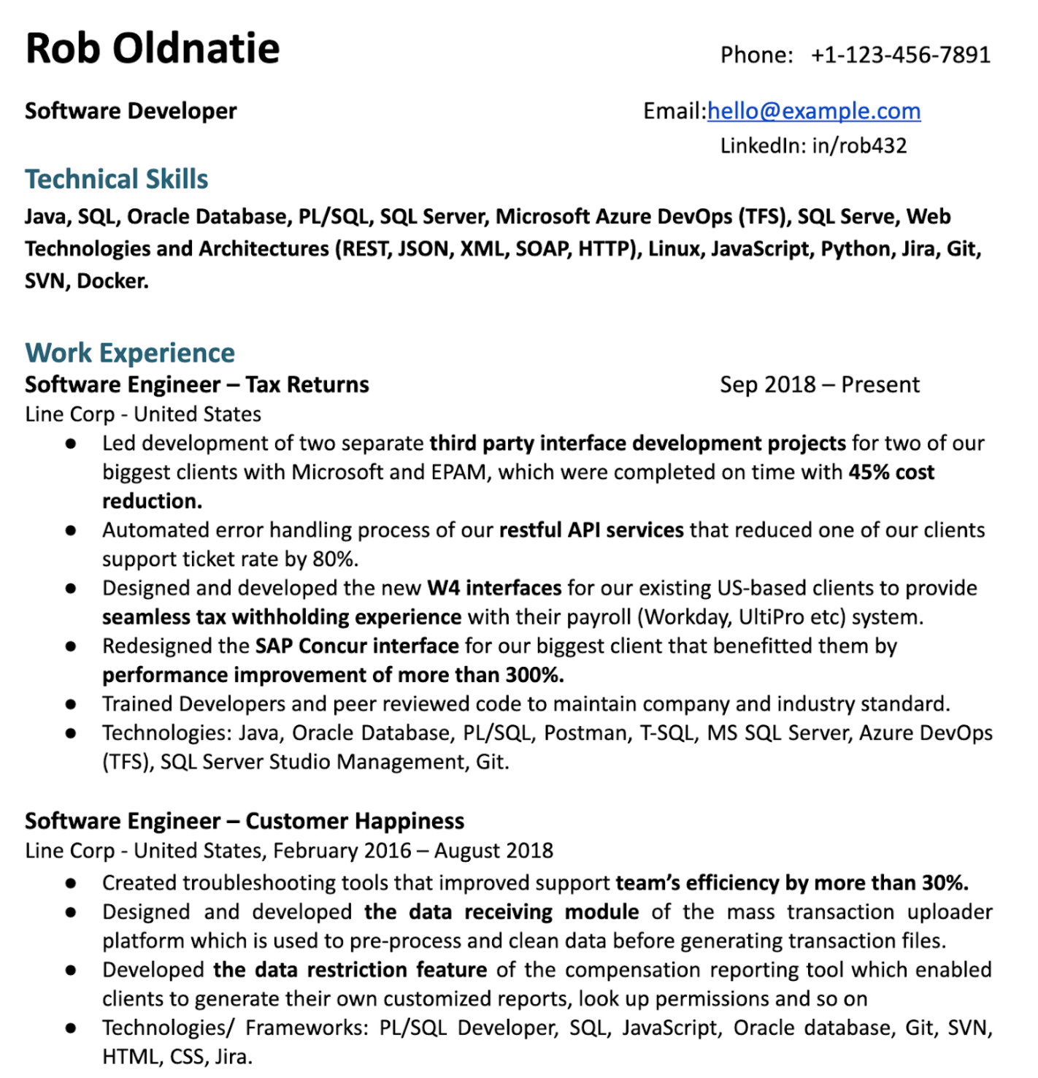
Find the Error

Slide 3
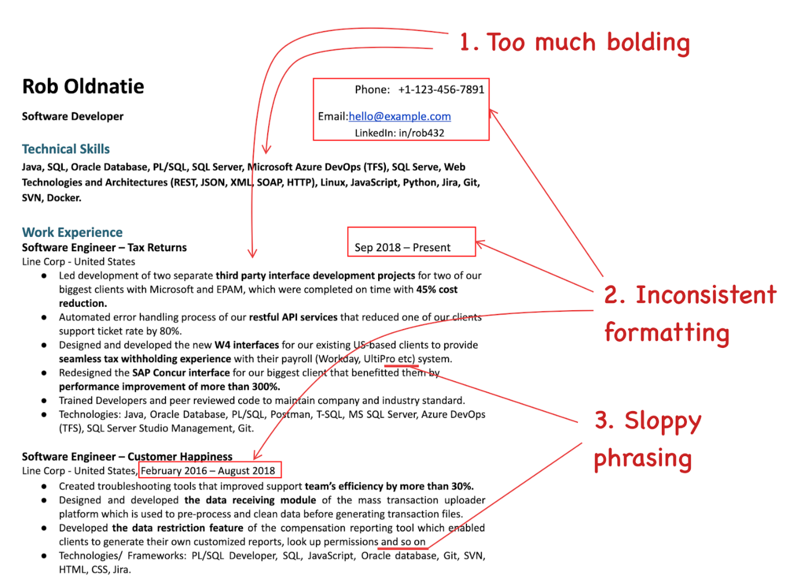
Did you even realize that?

Slide 4
Do you think a well-crafted resume impacts your interview performance?
Reasons:
Professionalism
Highlighting relevant skills and experiences
Creating a positive first impression
Guiding the interview
Confidence booster
Yes, a well-crafted resume can have a significant impact on your interview performance.

Slide 5

Why is a Resume so important?
Grabs the attention of employers and recruiters.
Sells your strongest skills and accomplishments.
Shows how you're a match for a position or project.
And most importantly, gets you a job interview!

Slide 6
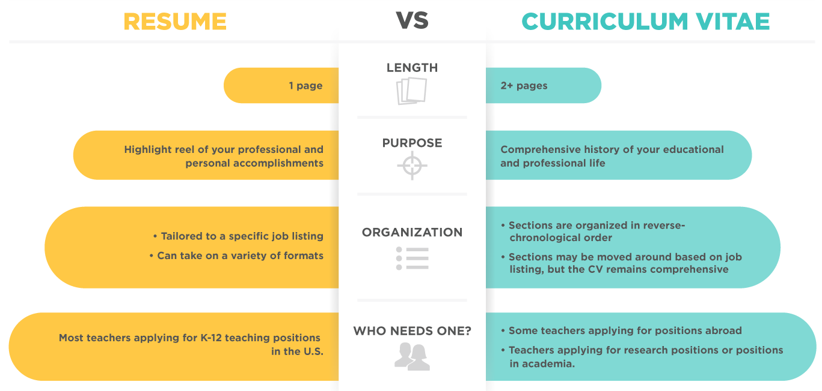
Difference between Resume & CV

Slide 7

What is your idea of ‘Efficient Resume’?

Slide 8

An Efficient Resume….
Lists your applicable experience and skills
Showcases the benefits you provide to companies
Attracts the attention of potential employers
Matches you to a job role
Might lead to an interview

Slide 9








Tips for Writing an Effective Resume
One page resume
Use appropriate font with 10-12
Optimize Simple Resume’s Header
Include a professional Summary
Outline your Achievements
Quantify your Accomplishments
Use bullet points
Plug-in Keywords

Slide 10
Tips for Writing an Effective Resume
Examine some industry-leading examples
Use professional fonts (Arial, Helvetica, Times New Roman and Calibri)
Include relevant information only
Sort contents based on importance
Explore the use of active language
Proofread and edit your copy

Slide 11
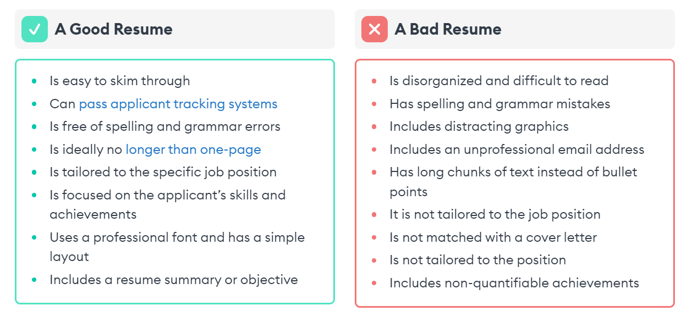
What really differentiates a good resume from a bad one?

Slide 12
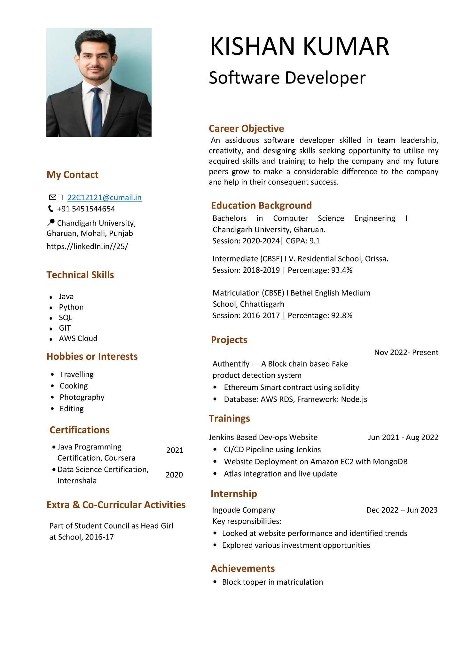

Slide 13
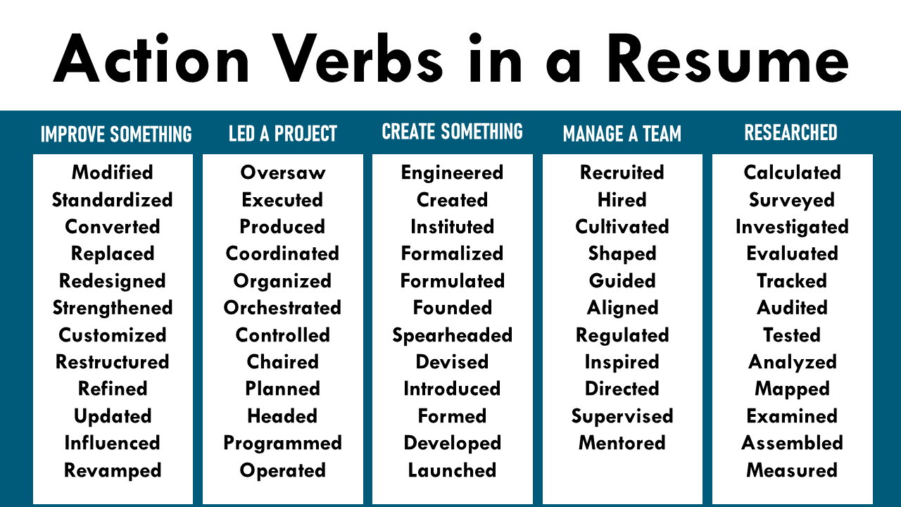

Slide 14
Activity: Resume Making
Make your resume on MS Word.
You have 30 minutes to build the same.
Remember to build it in only one page.
Also, remember to add all the required sections as learnt in the Sample Resume.

Slide 15



Slide 16

Thank you

